Slide 1
Need for Design
By Naveeth

Slide 2
Why do we need design?

Slide 3
Why do we need design?
Design is a huge factor in success of a product. A good design decides for how long people are going to use your product and if you are going to make some sense to your end users.

Slide 4
But first of all we need to understand what design really is?
Design, in simple words, is planning an optimal way to perform a certain task.

Slide 5
Design in the past : Humans have been designing things in one way or the other since thousands of years. Design has not only been a part of evolution but also a huge factor in survival of human species.

Slide 6
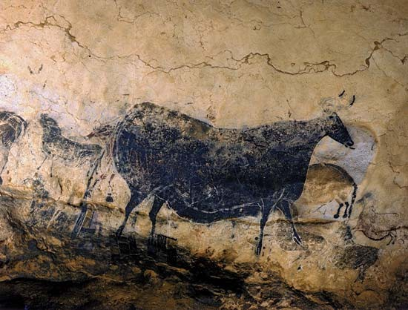
From designing figures in caves to communicate/note down an experience:

Slide 7
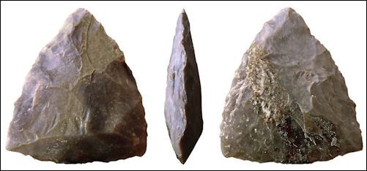
To Designing weapons and tools carved out of stones:

Slide 8
In Future
Design in Transport and Energy.
Design in Communication System
Design in Governance
Design in Physical and Digital Products.
Augmented Reality, Mixed Reality and Virtual Reality.

Slide 9
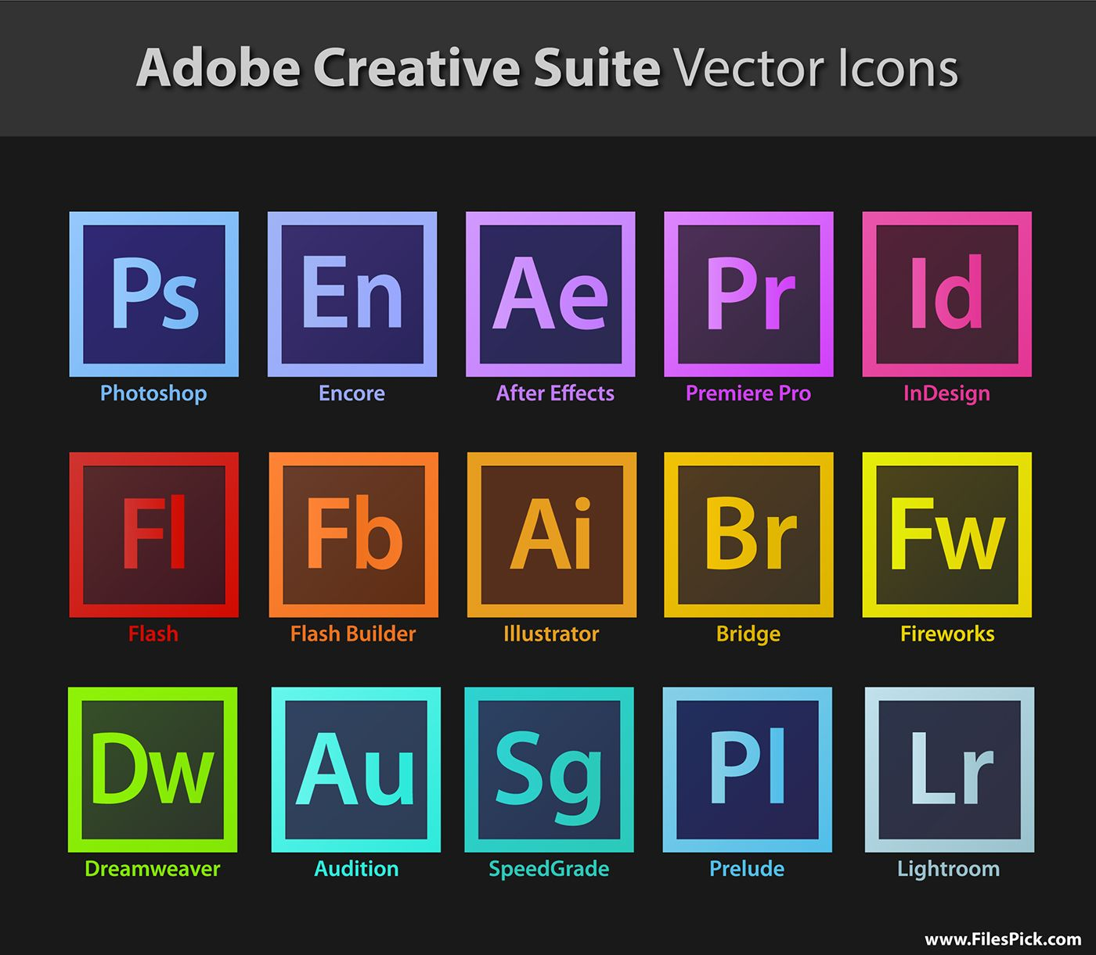

Slide 10
